Slide 1

Phase II Randomized, Multicenter Study of Lenalidomide vs Best Investigator’s Choice in Relapsed/Refractory Mantle Cell Lymphoma: Results of the MCL-002 (SPRINT) Study
Abstract 626
Trneny M, Lamy T, Walewski J, Jurczak W, Belada D,
Mayer J, Radford J, Alexeeva J, Osmanov D, Biyukov T, Patturajan M, Casadebaig Bravo M-L, Arcaini L,
on behalf of SPRINT trial investigators
Notes:
Publication Number: 626
Submission ID: 69212
Session Name: 624. Lymphoma: Therapy with Biologic Agents, excluding Pre-Clinical Models: Aggressive NHL Session Date: Monday, December 8, 2014 Session Time: 4:30 PM - 6:00 PM Presentation Time: 4:45 PM Room: Moscone Center, South Building, Esplanade 304-306-308
Accepted Abstract
Introduction: Mantle cell lymphoma (MCL) is an aggressive non-Hodgkin’s lymphoma with poor outcome, especially after failure of first-line treatment. Lenalidomide, an immunomodulatory drug with antineoplastic and antiproliferative effects, has shown activity in single-arm phase II studies of patients with relapsed/refractory (R/R) MCL. The present controlled randomized study compared the efficacy and safety of lenalidomide vs investigator’s choice (IC) in patients with R/R MCL.
Methods: MCL-002 (SPRINT), a European multicenter, open-label, phase II study enrolled patients with up to 3 relapses or who failed prior therapy and were ineligible for intensified treatment or stem cell transplantation (NCT00875667). Oral lenalidomide was given at 25 mg/day on days 1-21 of each 28-day cycle until progressive disease (PD) or intolerability. The IC treatment consisted of single-agent therapy with cytarabine, rituximab, gemcitabine, fludarabine, or chlorambucil. Patients who progressed on IC per investigator judgment were allowed to crossover to lenalidomide. The primary endpoint was progression-free survival (PFS); secondary endpoints included overall response rate (ORR), time to first response, duration of response (DOR), overall survival (OS), and safety. Response assessments were centrally reviewed using the modified IWG criteria.
Results: 254 patients with R/R MCL were randomized 2:1 to lenalidomide (n=170) or IC (n=84). Patients had median age 68.5 years, were predominantly male (73%), and had received a median of 2 prior therapies. 91% had stage III/IV disease at diagnosis, with 34% high-risk MIPI, 43% high tumor burden, and 20% bulky disease at baseline. Overall, patients on the lenalidomide arm had a worse prognostic profile than the IC arm due to higher tumor burden and disease risk (>5 percentage points for a number of parameters). After a median time of 2.9 months, 39 patients (46%) from the IC arm crossed over to lenalidomide due to PD. Overall, 84 patients remain on lenalidomide (15 having crossed over from IC) and 11 patients on IC without PD.
At a median follow-up time on study of 15.9 months, the risk reduction for PFS was 39% (HR=0.61 [95% CI, 0.44-0.84]; P=0.004; Table) in favor of lenalidomide (median PFS: 8.7 months lenalidomide vs 5.2 months IC). ORR was significantly improved for lenalidomide vs IC (40% vs 11%; CR/CRu 5% vs 0%). Median time to first response was 4.3 months for lenalidomide (not reached for IC). Median DOR (16.1 vs 10.4 months) and OS on mature data (27.9 vs 21.2 months) were longer for lenalidomide vs IC. Efficacy results were consistent among subgroups. Safety data in 250 patients receiving ≥1 dose showed more dose reductions in lenalidomide-treated patients (41%) vs IC (17%), due in part to a longer median duration of lenalidomide treatment vs IC, and to strict dose modification rules for lenalidomide. The most common grade 3/4 adverse events (AEs) were neutropenia (lenalidomide 44% vs IC 34% [without increased risk of infection]), thrombocytopenia (18% vs 28%), and leukopenia (8% vs 11%). Tumor flare reaction occurred in lenalidomide patients only (10%; 2% grade ≥3); 1 patient in each arm experienced tumor lysis syndrome. Invasive second primary malignancies were identified in 4% and 5% of lenalidomide and IC treated patients, respectively.
Conclusions: The MCL-002 study demonstrated a statistically significant and clinically meaningful improvement in PFS for lenalidomide over best IC monotherapy in patients with advanced R/R MCL despite a worse prognostic profile in the lenalidomide arm at baseline. In addition, ORR and CR rates, TTR, DOR, and OS were improved for lenalidomide over IC. The DOR has been remarkably consistent in various studies with lenalidomide in MCL patients. The safety profile for lenalidomide was as expected and no new safety signals were identified. The results of this first randomized, controlled study of lenalidomide showed superior efficacy compared to IC in patients with R/R MCL with a manageable toxicity profile.

Slide 2
Background and Rationale
Mantle cell lymphoma (MCL) is an aggressive
non-Hodgkin lymphoma with poor outcome, especially after failure of first-line treatment¹
Lenalidomide is an immunomodulatory drug with antineoplastic and antiproliferative effects²⁻⁴
Lenalidomide has shown activity in multiple single-arm phase II studies (NHL-002, NHL-003, MCL-001) in patients with relapsed/refractory (R/R) MCL⁵⁻⁷
First randomized trial with lenalidomide to compare with investigator's choice monotherapy in R/R MCL
1. Goy A, et al. Crit Rev Oncol Hematol. 2011;80(1):69-86; 2. Qian Z, et al. Leuk Res. 2011;35(3):380-386; 3. Wu L, et al. Clin Cancer Res. 2008;14(14):4650-4657; 4. Zhang L, et al. Am J Hematol. 2009;84(9):553-559; 5. Habermann TM, et al. Br J Haematol. 2009;145(3):344-349; 6. Zinzani PL, et al. Ann Oncol. 2013;24(11):2892-2897; 7. Goy A, et al. J Clin Oncol. 2013;31(29):3688-3695.
Trneny M, et al. Blood. 2014;124: Abstract 626.
Notes:
1. Goy and Kahl. Crit Rev Oncol Hematol. 2011;80:69-86.
2. Qian et al. Leuk Res. 2011;35:380-386.
3. Wu et al. Clin Cancer Res. 2008;14:4650-4657.
4. Zhang et al. Am J Hematol. 2009;84:553-559.
5. Habermann et al. Br J Haematol. 2009;145:344-349.
6. Zinzani et al. Ann Oncol. 2013;24:2892-2897.
7. Goy et al. J Clin Oncol. 2013;31:3688-3695.

Slide 3

MCL-002 (SPRINT): Phase II European Multicenter, Open-Label Study (5/2009-3/2013)
Lenalidomide†
25 mg/day PO, days 1-21, q28d
(until PD or toxicity)
R/R MCL (N = 254)
Pretreatment*
ECOG 0-2
Cyclin D1 or t(11;14)
Measurable disease ≥2 cm
2:1
Crossover to
lenalidomide
CT scans every
56 days for
6 months; then every 90 days thereafter
Stratification
<3 or ≥3 years from diagnosis
<6 vs ≥6 months from last systemic anti-lymphoma therapy
Prior SCT
Control: Investigator’s choice
If PD
Chlorambucil or rituximab until PD or toxicity
Cytarabine, fludarabine, or gemcitabine for ≤6 cycles
Primary endpoint: PFS (per independent central review)
Secondary endpoints: ORR, DOR, OS, and safety
  NCT00875667; data cut-off March 7, 2014.
  *Required ≥1 prior combination chemotherapy with alkylating agent, and anthracycline and/or cytarabine and/or fludarabine (± rituximab); ≤3 relapses or failure of prior therapy and ineligible for intensified treatment or SCT.
  †Prophylaxis for all lenalidomide patients included aspirin or low molecular–weight heparin prophylaxis for thromboembolic events and allopurinol or equivalent with oral hydration during the first 7 days for tumor lysis syndrome.
Trneny M, et al. Blood. 2014;124: Abstract 626.
Notes:
MCL-002 (SPRINT) is a phase II European multicenter, open-label study (NCT00875667; data cut-off March 7, 2014)
Main eligibility criteria
Age ≥18 years and ECOG PS 0-2
Histologically proven MCL with cyclin D1 overexpression by IHC or
t(11;14)(q13:q32) by FISH
Measurable lesion ≥2 cm by CT (or MRI if CT contraindicated)
Prior therapy
Required ≥1 prior combination chemotherapy with an alkylating agent, and anthracycline and/or cytarabine and/or fludarabine (± rituximab)
≤3 relapses or failure of prior therapy and ineligible for intensified treatment or stem cell transplantation
Response rates and time-to-event data were analyzed by independent central reviewers per modified IWG criteria and Kaplan-Meier estimates, respectively¹⁻⁴
Safety was assessed by NCI CTCAE version 3.0; tumor lysis syndrome was graded according to the Cairo-Bishop grading system⁵
PFS was defined as the time from randomization to the first observation of PD (per modified IWG criteria) or death due to any cause
Investigator’s choice treatment regimens (all given as a single agent)
Chlorambucil 40 mg/m² total monthly dose PO over 3-10 days, q28d until PD or toxicity
Rituximab 375 mg/m² IV days 1, 8, 15, and 22; q56d until PD or toxicity
Cytarabine 1-2 g/m² IV qd or bid days 1 and 2, q28d for up to 6 cycles
Fludarabine 25 mg/m² IV or 40 mg/m² PO days 1-5, q28d for up to 6 cycles
Gemcitabine 1,000 mg/m² IV days 1, 8, and 15; q28d for up to 6 cycles
CSR Table 34: Percent of patients receiving IC treatment (n = 83)
33% Rituximab (n = 27)
24% Gemcitabine (n = 20)
22% Fludarabine (n = 18)
13% Chlorambucil (n = 11)
8% Ara-C (n = 7)
References
1. Cheson et al. J Clin Oncol. 1999;17:1244.
2. Kane et al. Clin Cancer Res. 2007;13:5291-5294.
3. Fisher et al. J Clin Oncol. 2006;24:4867-4874.
4. Kaplan and Meier. J Am Stat Assoc. 1958;53:457-481.
5. Cairo and Bishop. Br J Haematol. 2004;127:3-11.

Slide 4
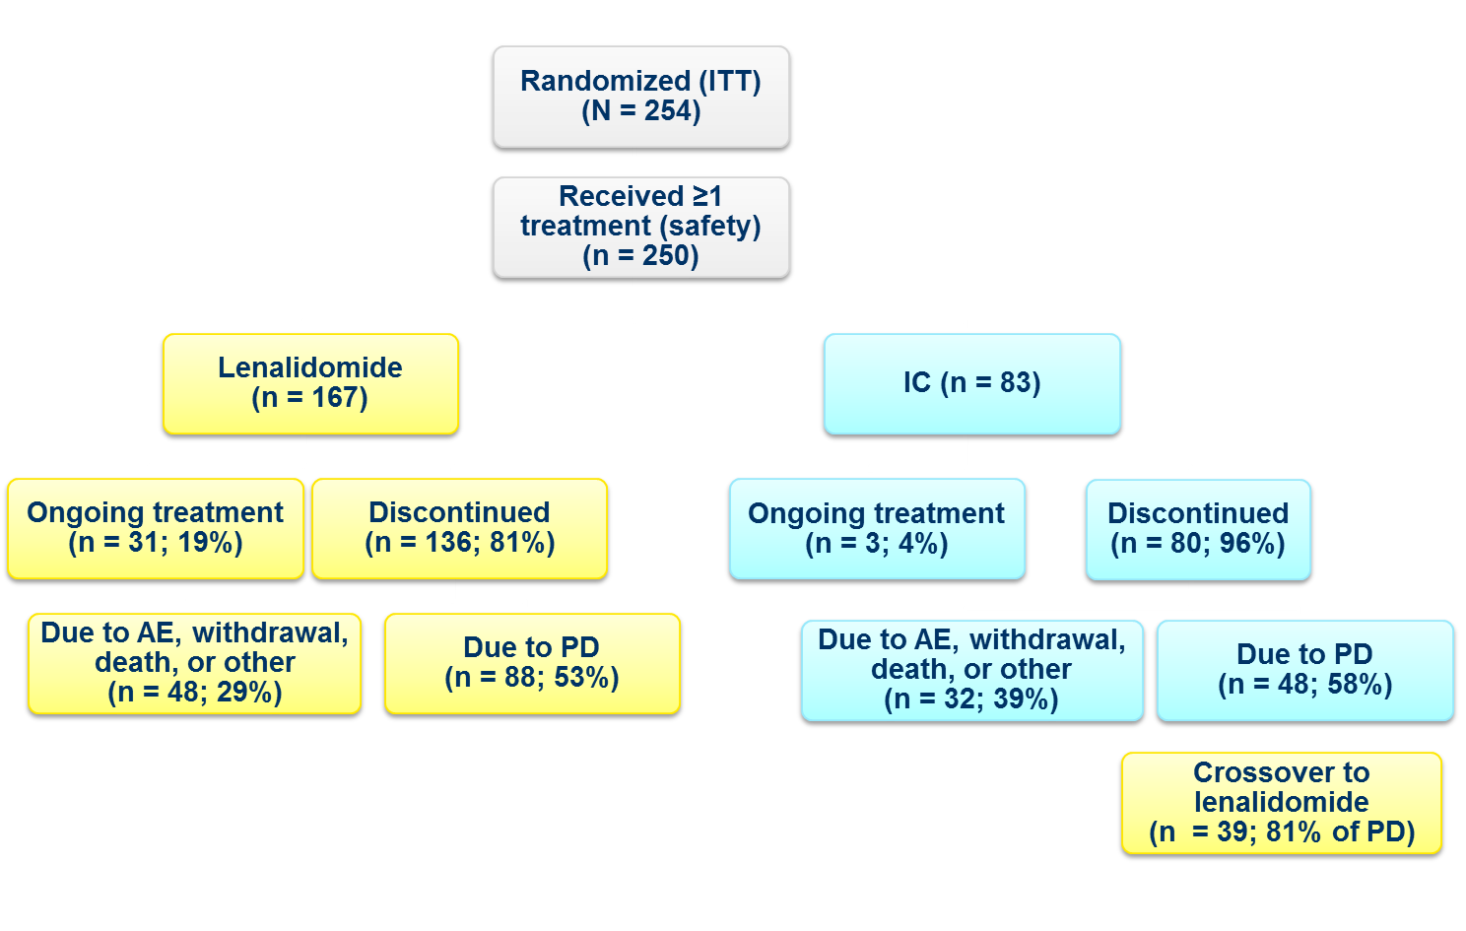
MCL-002: Disposition of Patients (5/2009-3/2013)
2:1
Median time to crossover = 2.9 months
14 patients received ongoing treatment or were in follow-up at data cut-off
Trneny M, et al. Blood. 2014;124: Abstract 626.
Notes:
CSR figure 2 and 3

Slide 5
Study Population

Slide 6
MCL-002: Baseline Demographics (ITT)
Characteristic, n (%) | Lenalidomide (n = 170) | IC (n = 84)
Median age, years (range) Age ≥65 years | 68.5 (44-88) 115 (68) | 68.5 (49-87) 57 (68)
Male | 123 (72) | 63 (75)
ECOG PS* 0-1 ≥2 | 142 (84) 27 (16) | 73 (87) 11 (13)
≥3-year duration of MCL | 76 (45) | 39 (46)
MCL stage at diagnosis I/II III IV Missing | 13 (8) 30 (18) 123 (72) 4 (2) | 3 (4) 20 (24) 59 (70) 2 (2)
MIPI score Low Intermediate High Missing | 42 (25) 66 (39) 60 (35) 2 (1) | 21 (25) 37 (44) 25 (30) 1 (1)
High LDH (>ULN)† | 73 (43) | 30 (36)
High tumor burden‡ | 81 (48) | 28 (33)
Bulky disease§ | 37 (22) | 13 (15)
>30% Ki-67 index | 31 (18) | 19 (23)
Despite stratification, patients receiving lenalidomide vs IC had a worse baseline prognostic profile (by ≥5%) due to higher disease risk by high-risk MIPI, high LDH,
high tumor burden, and bulky disease
Trneny M, et al. Blood. 2014;124: Abstract 626.
Notes:
Footnotes
*Baseline ECOG score was missing for 1 patient in the lenalidomide group.
†High LDH was considered 3.4 µkat/L for patients aged ≤60 years and 3.5 µkat/L for patients aged >60 years.
‡High tumor burden consisted of more than 1 lesion ≥5 cm in diameter or 3 lesions ≥3 cm in diameter.
§Bulky disease was more than 1 lesion ≥7 cm in diameter.
CSR Section 10
Table 17, p 110
Table 18, p 112
Data cut-off March 7, 2014

Slide 7
MCL-002: Baseline Treatment History (ITT)
Characteristic, n (%) | Lenalidomide (n = 170) | IC (n = 84)
Median number of prior treatment regimens (range) | 2 (1-5) | 2 (1-4)
Number of prior systemic anti-lymphoma therapies
1 2 3 ≥4 | 55 (32) 70 (41) 36 (21) 9 (5) | 37 (44) 23 (27) 20 (24) 4 (5)
Time from last prior systemic anti-lymphoma therapy
<6 months ≥6 months | 71 (42) 95 (56) | 36 (43) 47 (56)
Best response to last prior systemic anti-lymphoma therapy
CR/CRu PR SD PD Unknown | 58 (34) 42 (25) 31 (18) 33 (19) 6 (4) | 29 (35) 30 (36) 9 (11) 10 (12) 6 (7)
Received autologous SCT | 30 (18) | 18 (21)
37%
Refractory
23%
Refractory
Note: Baseline treatment history and prior response are missing for several patients in each arm.
Trneny M, et al. Blood. 2014;124: Abstract 626.
Notes:
CSR Section 10
Table 18, p 112-113
Table 20, p 117
Data cut-off March 7, 2014

Slide 8
Efficacy

Slide 9
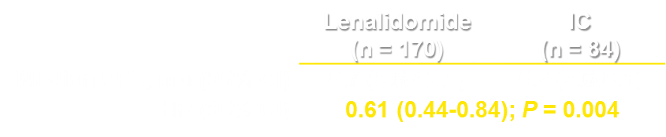

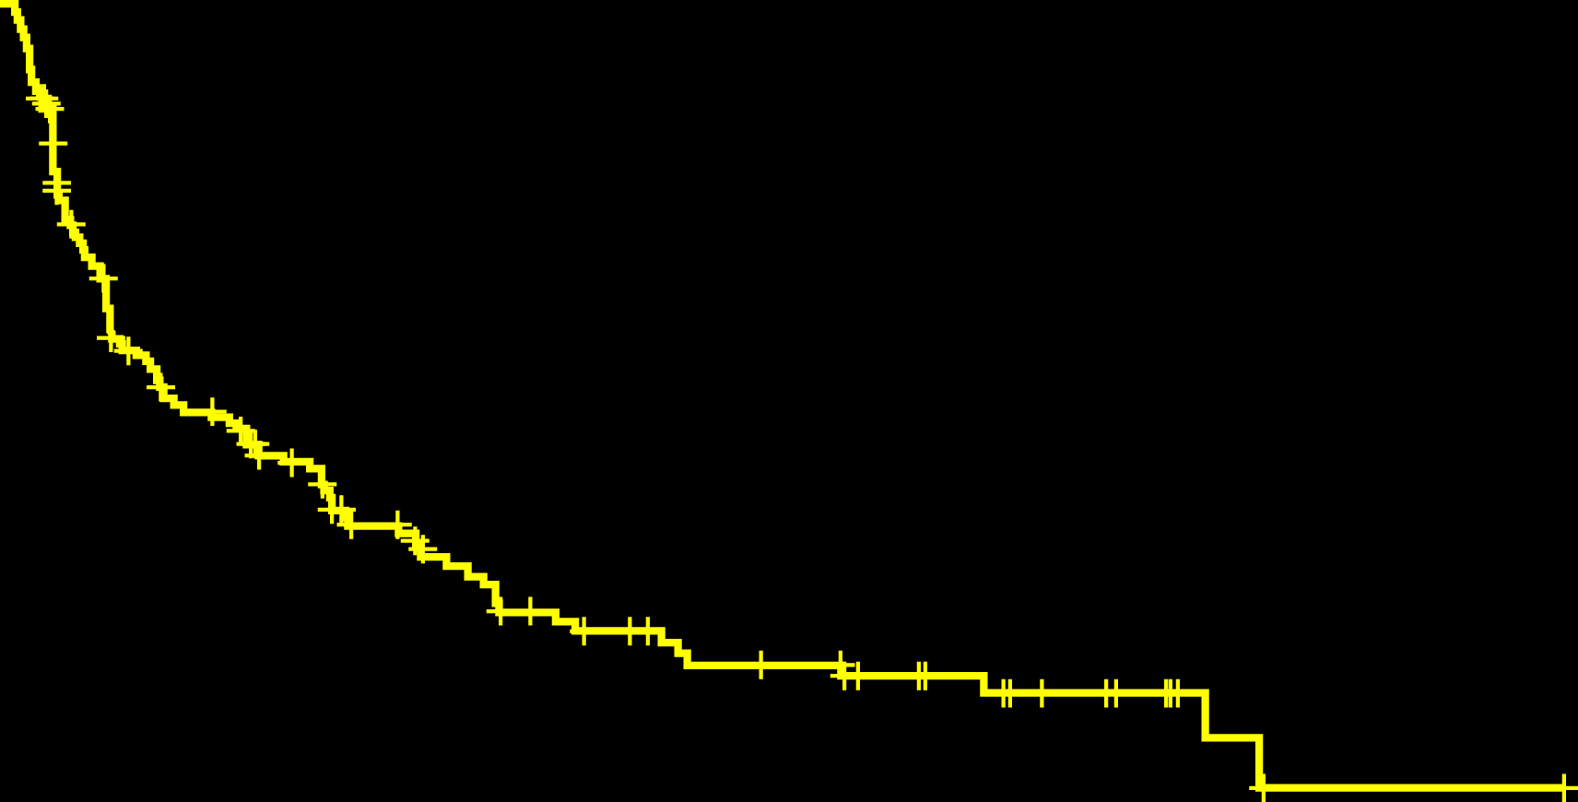
MCL-002: Progression-Free Survival (ITT)*
Lenalidomide vs IC showed a 39% reduction in the risk of PD or death, reflected as an estimated improvement in median PFS of 3.5 months
1.0
0.9
0.8
0.7
Lenalidomide
8.7 mo
0.6
0.5
Survival Probability
0.4
0.3
Control
5.2 mo
0.2
0.1
IC
Lenalidomide
0.0
0
5
10
15
20
25
30
35
40
45
50
55
Number of patients at risk
Progression-Free Survival, Months
Lenalidomide
IC
170
84
86
31
63
15
36
7
27
5
20
4
16
4
12
2
7
0
1
1
0
Median follow-up time: 15.9 months
*ICR, Data cut-off March 7, 2014.
Trneny M, et al. Blood. 2014;124: Abstract 626.
Notes:
HR was measured by 2 statistical tests
Sequential HR (shown in the slide) was the predefined statistical measure.
A second stratified HR was measured to provide additional sensitivity and robustness to the endpoint
Stratified HR = 0.63 (95% CI, 0.43-0.90); P = 0.012
CSR Section 11.4.1.1 and Table 22
PFS was defined as the time from randomization to the first observation of PD (per modified IWG criteria) or death due to any cause
Note about censoring:
Lenalidomide arm: patients were censored at the date of last adequate assessment followed by date of last adequate assessment prior to new anti-lymphoma treatment
IC arm: patients were censored at last adequate assessment prior to new anti-lymphoma therapy including crossover to lenalidomide, followed by last adequate assessment

Slide 10
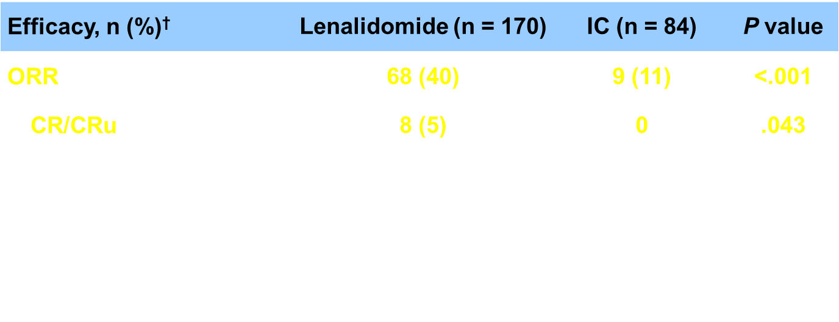
MCL-002: Efficacy (ITT)*
For 39 patients who crossed over from IC to lenalidomide, best responses included 2 (5%) CR, 4 (10%) PR, 3 (8%) SD†
*Data cut-off March 7, 2014.
†No response evaluations for several patients in each arm; however, they still contributed to PFS.
Trneny M, et al. Blood. 2014;124: Abstract 626.
Notes:
Response rates: CSR Section 11.4.1.2 and Table 23
DOR: SCE Section 3.2.3 & Table 14
OS: CSR Section 11.4.1.8; measured at median follow-up of 15.9 months
ORR and CR/CRu were statistically different for lenalidomide over IC.
Responses to Len were reported also in cross-over (impact on OS but demonstrated retained activity)
DOR was not statistically significant between arms due to the very small number of responders in IC arm
Comparable DOR across trials => it can be concluded that lenalidomide provides the same level of disease control regardless of the median number of prior lines of treatment.
Response data were missing for 18 lenalidomide and 5 IC patients, and 2 patients who crossed over.
(DOR was defined as the time from when the first response of CR, CRu, or PR was first achieved until documented PD or death from any cause, whichever occurred first)

Slide 11



MCL-002: OS (ITT)*
1.0
0.9
0.8
0.7
0.6
Survival Probability
0.5
0.4
0.3
Lenalidomide
IC
0.2
0.1
0.0
0
5
10
15
20
25
30
35
40
45
50
55
60
Number of patients at risk
Overall Survival, Months
Lenalidomide
IC
170
84
135
72
116
59
90
42
66
32
55
19
48
16
33
12
18
9
9
7
1
1
1
1
0
0
Median follow-up time: 15.9 months
In MCL-002, OS was not statistically powered for a direct comparison
Crossover for patients in the IC arm with PD was 47%†
Trneny M, et al. Blood. 2014;124: Abstract 626.
*Data cut-off March 7, 2014. †Based on safety population.
Notes:
OS: CSR Section 11.4.1.8; measured at median follow-up of 15.9 months
OS was defined as the time from randomization until death from any cause
Note about censoring:
Lenalidomide arm: patients were censored at the date of last adequate assessment followed by date of last adequate assessment prior to new anti-lymphoma treatment
IC arm: patients were censored at last adequate assessment prior to new anti-lymphoma therapy including crossover to lenalidomide, followed by last adequate assessment

Slide 12
Safety

Slide 13
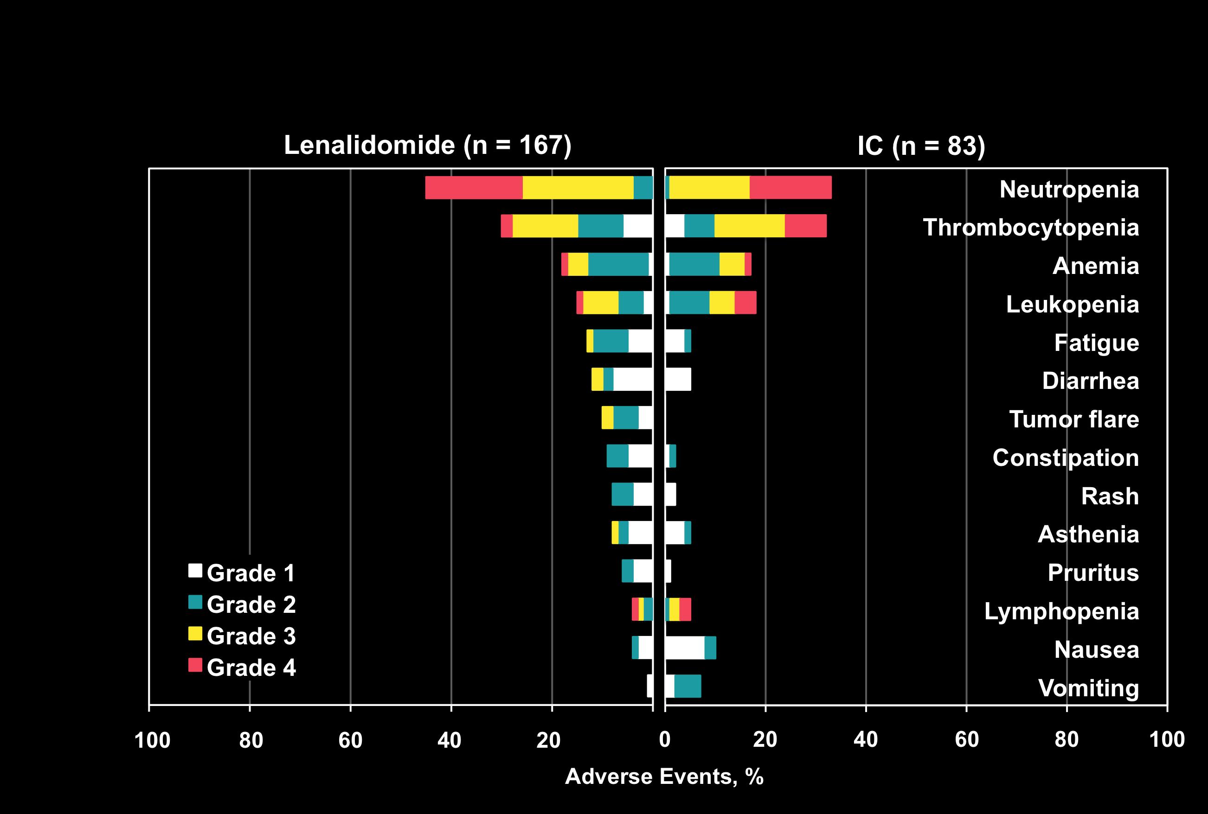
MCL-002: Treatment-Related AEs (≥5%)*
Median treatment duration was 24.3 weeks for lenalidomide vs 13.1 weeks for IC
Lenalidomide-treated patients showed more dose reductions vs IC (41% vs 17%),
due in part to longer median duration and strict dose modification rules for lenalidomide
*Safety analyses were performed in all patients who received ≥1 dose of treatment with a data cut-off March 7, 2014.
Trneny M, et al. Blood. 2014;124: Abstract 626.
Notes:
CSR Tables 34 and 39
Duration of dosing: Table 14.3.1.1.4; CSR section 12.1.3, pg 168
Len 24.3 weeks (range: 0.4, 241.9), Control Arm, 13.1 weeks (range: 0.1, 157.9)
Additional dosing information
Average dose intensity of lenalidomide was 17 mg/day (SD = ±7 mg/day) for an average of 33 weeks (±37)
Lenalidomide was given in 84% of patients for ≥2 cycles, 50% for ≥6 cycles and 41% for ≥10 cycles
Although a higher percentage of subjects receiving treatment in the Lenalidomide Arm (41.3%) had dose reductions compared with the Control Arm (16.9%), the median time on study drug until first reduction was also improved in the Lenalidomide Arm (median time until first reduction, 10.0 and 5.2 weeks, respectively).
In the Lenalidomide Arm, considering the starting dose adjustment as per renal function at baseline, the median relative dose of lenalidomide was 84.7% in subjects who started at 25 mg and 78.9% in subjects who started at 10 mg, with mean dose intensities of 19.6 and 9.0 mg/day, respectively. In the Control Arm, complete or almost complete planned doses of each investigator’s choice drug were given. The exception was gemcitabine treatment, which had the greater number of dose reductions and skipped doses because of safety reasons.

Slide 14
MCL-002: Grade 3/4 Treatment-Related AEs (≥5%)*
Grade ≥3 AE, n (%) | Lenalidomide (n = 167) | IC (n = 83)
Neutropenia | 73 (44) | 28 (34)
Thrombocytopenia | 30 (18) | 23 (28)
Anemia | 14 (8) | 6 (7)
Leukopenia | 13 (8) | 9 (11)
Febrile neutropenia | 10 (6) | 2 (2)
Lymphopenia | 2 (1) | 5 (6)
*Safety analyses were performed in all patients who received ≥1 dose of treatment with a data cut-off March 7, 2014.
Trneny M, et al. Blood. 2014;124: Abstract 626.
Notes:
CSR Table 40 , pg 175
CSR Section 12.3.3.4.1.1, pg 196 Neutropenia
Growth factors (G-CSF) were used more frequently for lenalidomide (30%) than IC (23%) patients to manage dose-limiting neutropenia
CSR Section 12.3.3.4.2.1, pg 199-200 Thrombocytopenia
Concomitant platelet transfusions were administered more for IC (11%) than lenalidomide (4%)
CSR Section 12.3.3.4.12, pg 222, TLS
Only TLS for patient in IC arm was classified as grade 3-5 event (lenalidomide patients had grade 1 TLS); neither lenalidomide nor IC arm events were deemed a SAE
Patient in lenalidomide arm with grade 1 TLS received concomitant treatment with allopurinol; no change in lenalidomide. Patient had extranodal disease of liver and bone marrow at enrollment
Patient in IC arm with grade 3 TLS was treated with calcium gluconate. Patients had extranodal bulky disease of stomach, ascending large instestine, and rectum at study entry, and had concurrent grade 3 acute renal failure and abdominal pain/distention. Patient died on the day of TLS onset due to acute heart failure.
CSR Section 12.3.3.4.13, pg 222, TFR
TFR occurred in 16 patients (10%) receiving lenalidomide; none in IC arm.
For lenalidomide arm only: Most TFRs were grade 1/2; all but 1 patient continued study treatment and all but 1 occurred during cycle 1
Median time to first TFR was 1.1 weeks; duration of TFR was 4-83 days.
Concomitant therapy included corticosteroids, analgesics, and antibacterial; 13 patients had no change in study drug (withdrawn in 1).
Three patients had grade 3 TFR (none grade 4/5); 1 patient had grade 3 TFR resulting in study discontinuation (interrupted/reduced in 2).

Slide 15
MCL-002: Adverse Events of Interest
Thromboembolic events occurred in 11 % of lenalidomide patients and 1% of IC patients
Tumor flare reaction occurred in 10% of lenalidomide patients (2% grade ≥3)
1 patient in each arm experienced tumor lysis syndrome
Invasive second primary malignancies were identified in
4% of lenalidomide and 5% of IC-treated patients
Trneny M, et al. Blood. 2014;124: Abstract 626.
Notes:
CSR Table 40 , pg 175
CSR Section 12.3.3.4.1.1, pg 196 Neutropenia
Growth factors (G-CSF) were used more frequently for lenalidomide (30%) than IC (23%) patients to manage dose-limiting neutropenia
CSR Section 12.3.3.4.2.1, pg 199-200 Thrombocytopenia
Concomitant platelet transfusions were administered more for IC (11%) than lenalidomide (4%)
CSR Section 12.3.3.4.12, pg 222, TLS
Only TLS for patient in IC arm was classified as grade 3-5 event (lenalidomide patients had grade 1 TLS); neither lenalidomide nor IC arm events were deemed a SAE
Patient in lenalidomide arm with grade 1 TLS received concomitant treatment with allopurinol; no change in lenalidomide. Patient had extranodal disease of liver and bone marrow at enrollment
Patient in IC arm with grade 3 TLS was treated with calcium gluconate. Patients had extranodal bulky disease of stomach, ascending large instestine, and rectum at study entry, and had concurrent grade 3 acute renal failure and abdominal pain/distention. Patient died on the day of TLS onset due to acute heart failure.
CSR Section 12.3.3.4.13, pg 222, TFR
TFR occurred in 16 patients (10%) receiving lenalidomide; none in IC arm.
For lenalidomide arm only: Most TFRs were grade 1/2; all but 1 patient continued study treatment and all but 1 occurred during cycle 1
Median time to first TFR was 1.1 weeks; duration of TFR was 4-83 days.
Concomitant therapy included corticosteroids, analgesics, and antibacterial; 13 patients had no change in study drug (withdrawn in 1).
Three patients had grade 3 TFR (none grade 4/5); 1 patient had grade 3 TFR resulting in study discontinuation (interrupted/reduced in 2).

Slide 16
Conclusions

Slide 17
MCL-002: Conclusions
MCL-002 was the first randomized, controlled study of lenalidomide vs IC in patients with R/R MCL
Trneny M, et al. Blood. 2014;124: Abstract 626.

Slide 18
MCL-002: Conclusions
MCL-002 was the first randomized, controlled study of lenalidomide vs IC in patients with R/R MCL
Lenalidomide showed significantly improved PFS over IC monotherapy in patients with advanced R/R MCL
  39% risk reduction in disease progression or death
  (HR = 0.61; P = 0.004)
    Median PFS = 8.7 vs 5.2 months
Trneny M, et al. Blood. 2014;124: Abstract 626.

Slide 19
MCL-002: Conclusions
MCL-002 was the first randomized, controlled study of lenalidomide vs IC in patients with R/R MCL
Lenalidomide showed significantly improved PFS over IC monotherapy in patients with advanced R/R MCL
  39% risk reduction in disease progression or death
  (HR = 0.61; P = 0.004)
    Median PFS = 8.7 vs 5.2 months
Responses were significantly improved for lenalidomide vs IC
  ORR = 40% vs 11% (P<.001)
  CR/CRu = 5% vs 0 (P<.043)
Trneny M, et al. Blood. 2014;124: Abstract 626.

Slide 20
MCL-002: Conclusions
MCL-002 was the first randomized, controlled study of lenalidomide vs IC in patients with R/R MCL
Lenalidomide showed significantly improved PFS over IC monotherapy in patients with advanced R/R MCL
  39% risk reduction in disease progression or death
  (HR = 0.61; P = 0.004)
    Median PFS = 8.7 vs 5.2 months
Responses were significantly improved for lenalidomide vs IC
  ORR = 40% vs 11% (P<.001)
  CR/CRu = 5% vs 0 (P<.043)
Lenalidomide had a good safety profile
Trneny M, et al. Blood. 2014;124: Abstract 626.

Slide 21
MCL-002: Conclusions
MCL-002 was the first randomized, controlled study of lenalidomide vs IC in patients with R/R MCL
Lenalidomide showed significantly improved PFS over IC monotherapy in patients with advanced R/R MCL
  39% risk reduction in disease progression or death
  (HR = 0.61; P = 0.004)
    Median PFS = 8.7 vs 5.2 months
Responses were significantly improved for lenalidomide vs IC
  ORR = 40% vs 11% (P < 0.001)
  CR/CRu = 5% vs 0 (P < 0.043)
Lenalidomide had a good safety profile
Lenalidomide showed superior efficacy and positive benefit : risk ratio in these patients
Trneny M, et al. Blood. 2014;124: Abstract 626.

